Slide 1
Unity Flash EPG Architecture and Development Environment overview

Slide 2
Agenda
Flash Overview
STB Architecture
EPG Architecture
Deployment

Slide 3
Flash Overview

Slide 4
Tools & Technologies
Adobe CS5
CS5 used to define the UI layout & 2D timeline animation
FlashLite 4.0
ActionScript 3.0
Adobe Illustrator
Studio Design uses Illustrator to define the images to be used in the Flash EPG.
Cinema 4D
Studio Design defines 3D animations to be used in EPG
Notes:
AS3 is supported from Flash player 9 and above
Adobe Flash Lite is a profile for use in handsets that utilizes Flash 10 objects and ActionScript 3.
Bluestreak Legacy flash engine
SWF – Flash Executable
SWC – Flash Component
MovieClip- ActionScript creation that allows easy usage of visible objects

Slide 5
Terminologies
SWF – Flash Executable
SWC – Flash Component
MovieClip- Key element in Flash to create animated content with the Flash authoring tool
FLA – Flash CS Authoring File
Timeline Animations – Animations authored in Flash CS5 on
COLLADA – COLLAborative Design Activity an interchange file format for 3D applications
AVM – Action Script Virtual Machine

Slide 6
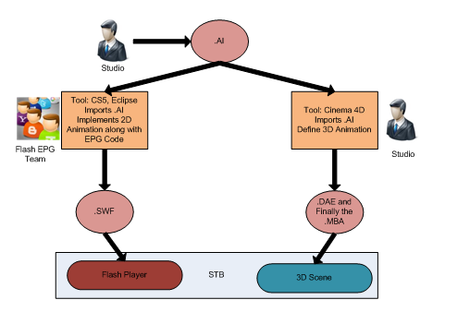
EPG Workflow

Slide 7
STB Architecture

Slide 8
STB Software Architecture
Flash EPG
Adobe AS API
NDS User API (AS)
Adobe Flash Player
CORE
Porting
UAPI Bindings
Fusion
Porting
User API (Native)
UAS
DFAS
App Engine
DMS
CORE
Fusion
DV3
GFX

Slide 9
EPG Architecture

Slide 10
Objective
To provide a scalable framework for developing various flavors of EPGs.
To reduce time to market by creating reusable, modifiable and configurable components.

Slide 11
Key Definitions
Widgets are classified into basic and domain widgets. Basic Widgets are fundamental elements of user interface. Domain Widgets are fully implemented user interface of the domain data.
Screen represents the user interface layout and contains Domain & Basic Widgets and handles navigation among them.
Aux App is composed of one or more screens that are related. EPG is composed of multiple Aux Apps which can be resident or downloaded at runtime.

Slide 12
Multilayered
Unity CORE Foundation
Foundation provides frameworks and domain services to build any flavor of Flash EPG.
Aux App Model is realized as domain service.
Unity CORE Aux Apps
Controller and View classes of Aux Apps
State Management
Unity EPG UI
This is the Presentation Layer specific to a customer.
Presentation
Controller & View
Model

Slide 13
Unity EPG

Slide 14
Widgets
Unity EPG will provide
Framework to build customizable widgets
Catalog of widgets
Widgets will be added into the screens as per the demands of the EPG’s Story board.
The widgets are classified into two categories:
Basic Widgets : Fundamental building blocks used in a screen or domain widget e.g., List, Table, etc.
Domain Widgets : Made up of one or more basic widgets to provide a specific UI representation of a business data e.g. Guide, Channel Bar, Search Result, etc.

Slide 15
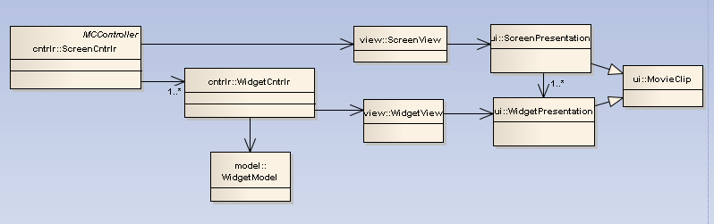
MVC-P
The Unity EPG uses the MVC pattern for Screens and Widgets.

Slide 16
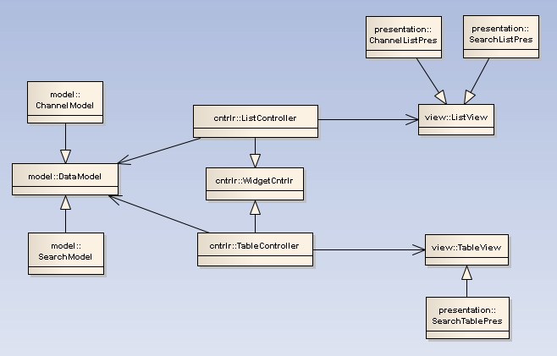
MVC-P : Realization in Widgets
Realized using Template Pattern
Notes:
Considering Conservative AVM

Slide 17
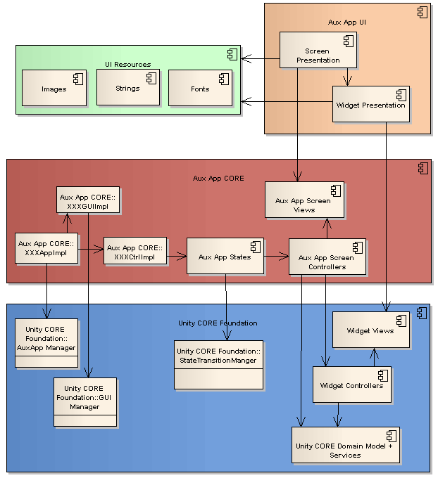
Aux App

Slide 18
Aux App – Cont…
Aux App - CORE
The Aux App CORE
is a common code supporting UI design and navigation paradigm which is tailored via configuration to support different customers.
Each Aux App
Implements the interfaces for App, Ctrl and GUI which takes care of App transition, GUI transitions and Key dispatch.
Have its own states that are managed by an instance of the State Transition.
Have Screen controllers that use specific and reusable widget controllers to handle UI and widget navigation.
Have Separate configuration files to support tailoring needs.

Slide 19
Aux App– Cont…
Aux App – UI
The Aux App UI is specific to a look (customer). Handles
UI Layout and Definition of UI elements in FLA
Assets (Images) in FLA
Presentation of Screen & Widget UI
Animation definition in .DAE for 3D or in Code or in Timeline

Slide 20
Tailoring
Feature Configuration
Every feature in EPG will have the support for:
Enabling & Disabling Features and Sub-Features
Configuring Data required for Features and Sub-Features
GUI Configuration
Images
Strings Tables
Fonts
Animations
Feature Profiling
Statically includes or omits features (code) when building Unity Flash EPG for a customer.
Navigational flow changes
Across screens
Within a screen

Slide 21
2D – 3D Animations
Unity Flash EPG needs to be supported on STBs
with & without
OPEN GLES support
STB with Open GLES support, can have both 3D and 2D animations.
3D animation defined in Cinema 4D and executed by 3D Engine
2D animation where ever applicable defined in action script or timeline and executed by Flash Player.
STB without OPEN GLES support, has only 2D animation
2D animation where ever applicable defined in action script or timeline and executed by Flash Player.

Slide 22
Deployment

Slide 23
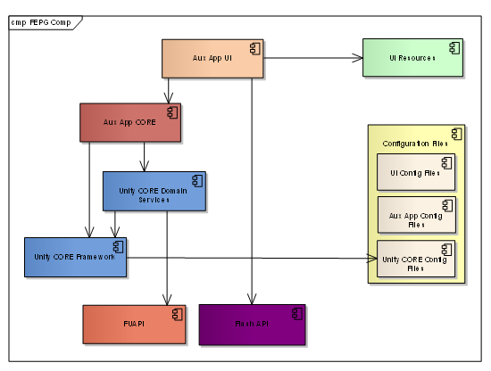
Unity Component Dependency

Slide 24
Deployment
The Unity Flash EPG modules along with feature configurations are built together into one executable (FEPG.SWF)
The following resources required for the executable are placed in the resource folder:
String Tables as XML
Font Configurations as XML
Font files as TTF
Images as a separate SWF
3D Animations files as .DAE & XML

Slide 25
THANKS

